Slide 1
Five in Five
July 2025

Slide 2
Treasury Yields
S&P 500 Energy Sector
S&P 500
S&P 500
Dollar General
Mag 7
Dollar General
Mag 7
Mag 7
Mag 7
Dollar Tree
Dollar Tree
WTI ($/bbl)
WTI ($/bbl)
Sources: BTC Capital Management, Bloomberg
Price action on the 10-year Treasury may be giving early clues to lower yields.
Red arrows signified when pullbacks after a rally were too deep to suggest a new trend.
Blue arrows show “quiet” pullbacks after a rally that imply a breakout could be sustainable.
The offset is that this logic failed in 2023, along with no medium-term trend to lower yields.

Slide 3
Corporate Bonds
S&P 500 Energy Sector
S&P 500
S&P 500
Dollar General
Mag 7
Dollar General
Mag 7
Mag 7
Mag 7
Dollar Tree
Dollar Tree
WTI ($/bbl)
WTI ($/bbl)
Sources: BTC Capital Management, Bloomberg
Corporate bonds are the best performing fixed income sector over the last year.
Corporate bonds have outpaced Treasurys by 1.24% annually over the last 30 years.
We maintain a generally favorable view toward corporate bonds.

Slide 4
Large Cap Growth Stocks
Finish Q2 Strong
S&P 500 Energy Sector
 |  | Value | Core | Growth
Large |  | +2.5% | +10.6% | +18.7%
Mid |  | +3.1% | +6.3% | +9.4%
Small |  | +1.9% | +4.4% | +6.9%
Q2 2025
Services
S&P 500
Services
S&P 500
Dollar General
Mag 7
Dollar General
Mag 7
Mag 7
Mag 7
Mag 7
Mag 7
Mag 7
Dollar Tree
Dollar Tree
Manufacturing
WTI ($/bbl)
Manufacturing
WTI ($/bbl)
Source: PSC Portfolio Strategy
After underperforming on a relative basis during the first part of the year, large cap Growth stocks rebounded during the second quarter, far outpacing other style/size categories, and have now closed the gap versus Value on a year-to-date basis.
In particular, the Magnificent 7 group of stocks outpaced the broad index by almost 7% during the second quarter.
Upwards earnings revisions for U.S. stocks have been rising recently, outpacing downwards earnings revisions, as analysts have become more bullish regarding the market’s outlook.

Slide 5
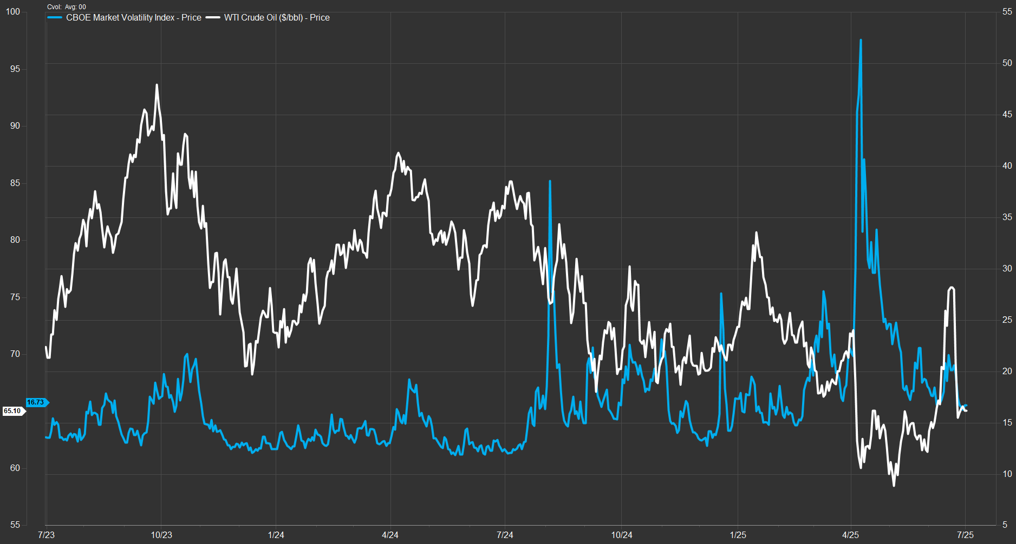
Market Volatility Relatively
Low Despite Volatile Oil Prices
Mag 7
S&P 500 Energy Sector
Corporate Bond Spreads Widen
S&P 500 Energy Sector
Corporate Bond Spreads Widen
Consumer Staples
Consumer Staples
Consumer Staples
WTI
S&P 500
S&P 500
S&P 500
Mag 7
Dollar General
Dollar General
Mag 7
Dollar General
Dollar General
Dollar General
Mag 7
Dollar General
Mag 7
Mag 7
Mag 7
Mag 7
Mag 7
Dollar Tree
Dollar Tree
Mag 7
Mag 7
Mag 7
Mag 7
Dollar Tree
Dollar Tree
Dollar Tree
Dollar Tree
Health Care
WTI ($/bbl)
WTI ($/bbl)
Health Care
Health Care
4/8/25 – market bottom
VIX
Sources: BTC Capital Management, FactSet
Oil prices (left axis) have seen much volatility in the last few months, from $60 in early May, rising to $76 in mid-June, and back down to $65 this week.
Market volatility, as measured by VIX (right axis), was not in sync with the increased volatility in West Texas Intermediate (WTI). In fact, it fell for most of May and fluctuated to some degree in June.
Historically, there has been a strong correlation between rising volatility in the stock market and oil prices. However, that relationship has broken down as investors seem to have shrugged off the recent price movements in WTI.

Slide 6
Large Cap Growth Stocks
Exhibiting Strong Earnings
S&P 500 Energy Sector
S&P 500 Energy Sector
S&P 500
S&P 500
Dollar General
Mag 7
Dollar General
Mag 7
Mag 7
Mag 7
Dollar Tree
Dollar Tree
WTI ($/bbl)
Sources: BTC Capital Management, FactSet
For the next twelve months, earnings-per-share (NTM EPS) are expected to grow year-over-year for the MSCI USA series of indexes, which includes MSCI USA (large cap core – blue line), MSCI USA Growth (large cap growth – green line), MSCI USA Value (large cap value – purple line), and MSCI USA Small Cap (small cap core – yellow line).
Anchoring each tail of this spectrum are large cap growth, which exhibits the highest estimated NTM EPS growth (+17.8%), while large cap value exhibits the lowest estimated NTM EPS growth (+0.6%).
Falling within the two extremes are large cap core (+7.9%) followed by small cap core (+3.4%).
Small cap core exhibits an attractive, relative valuation when considering its price-to-earnings growth ratio (PEG) of 1.5x. Surprisingly, the PEG for large cap growth (2.2x) approximates that of large cap value (2.1x).
The perceived sustainability of EPS growth within large cap, specifically large cap growth and large cap core, may support the projected premium valuation over small cap.

Slide 7
Disclosures
S&P 500 Energy Sector
Sources: BTC Capital Management, Bloomberg, FactSet, LSEG Datastream
The information provided has been obtained from sources deemed reliable, but BTC Capital Management and its affiliates cannot guarantee accuracy. Past performance is not a guarantee of future returns. Performance over periods exceeding 12 months has been annualized.
This document is intended for informational purposes only and is not an offer or solicitation with respect to the purchase or sale of any security. Statements in this report are based on the views of BTC Capital Management and on information available at the time this report was prepared. Rates are subject to change based on market and/or other conditions without notice. This commentary contains no investment recommendations, and you should not interpret any statement in this report as investment, tax, legal, and/or financial planning advice. All investments involve risk, including the possible loss of principal. Investments are not FDIC insured and may lose value.
S&P 500
Mag 7
Dollar General
Mag 7
Dollar Tree
WTI ($/bbl)

