Slide 1
Five in Five
June 2025

Slide 2
Treasury Yields
S&P 500 Energy Sector
S&P 500
Mag 7
Dollar General
Mag 7
Dollar Tree
WTI ($/bbl)
Sources: BTC Capital Management, Bloomberg
The 10-year implied average inflation rate is 2.2%.
Higher interest rates are not due to higher expected inflation.
Nominal GDP averaged 4.1% in the 20 years prior to COVID.
The 10-year Treasury at 4.5% seems to imply 2.3% real GDP with 2.2% inflation.

Slide 3
Corporate Bonds
S&P 500 Energy Sector
S&P 500
Mag 7
Dollar General
Mag 7
Dollar Tree
WTI ($/bbl)
Sources: BTC Capital Management, Bloomberg
Despite the CBOE Volatility Index (VIX) hitting 60 twice in the last year, drawdowns have been minimal.
Corporate bonds generally fare better if all-in yields are high.
Credit fundamentals remain strong.

Slide 4
Large Cap Growth Stocks
Rally in May
S&P 500 Energy Sector
May 2025
 |  | Value | Core | Growth
Large |  | +2.8% | +6.2% | +9.3%
Mid |  | +4.3% | +5.3% | +6.1%
Small |  | +4.1% | +5.1% | +5.9%
S&P 500
Services
Mag 7
Dollar General
Mag 7
Mag 7
Mag 7
Dollar Tree
Dollar Tree
WTI ($/bbl)
Manufacturing
Source: PSC Portfolio Strategy
After falling almost 9% during the first four months of the year, large cap Growth stocks recovered their losses during the month of May.
Investors adopted a “risk-on” mentality during May, rotating back into sectors such as Information Technology.
Value stocks posted a positive gain as well during May and are still outperforming Growth stocks year-to-date (YTD).

Slide 5
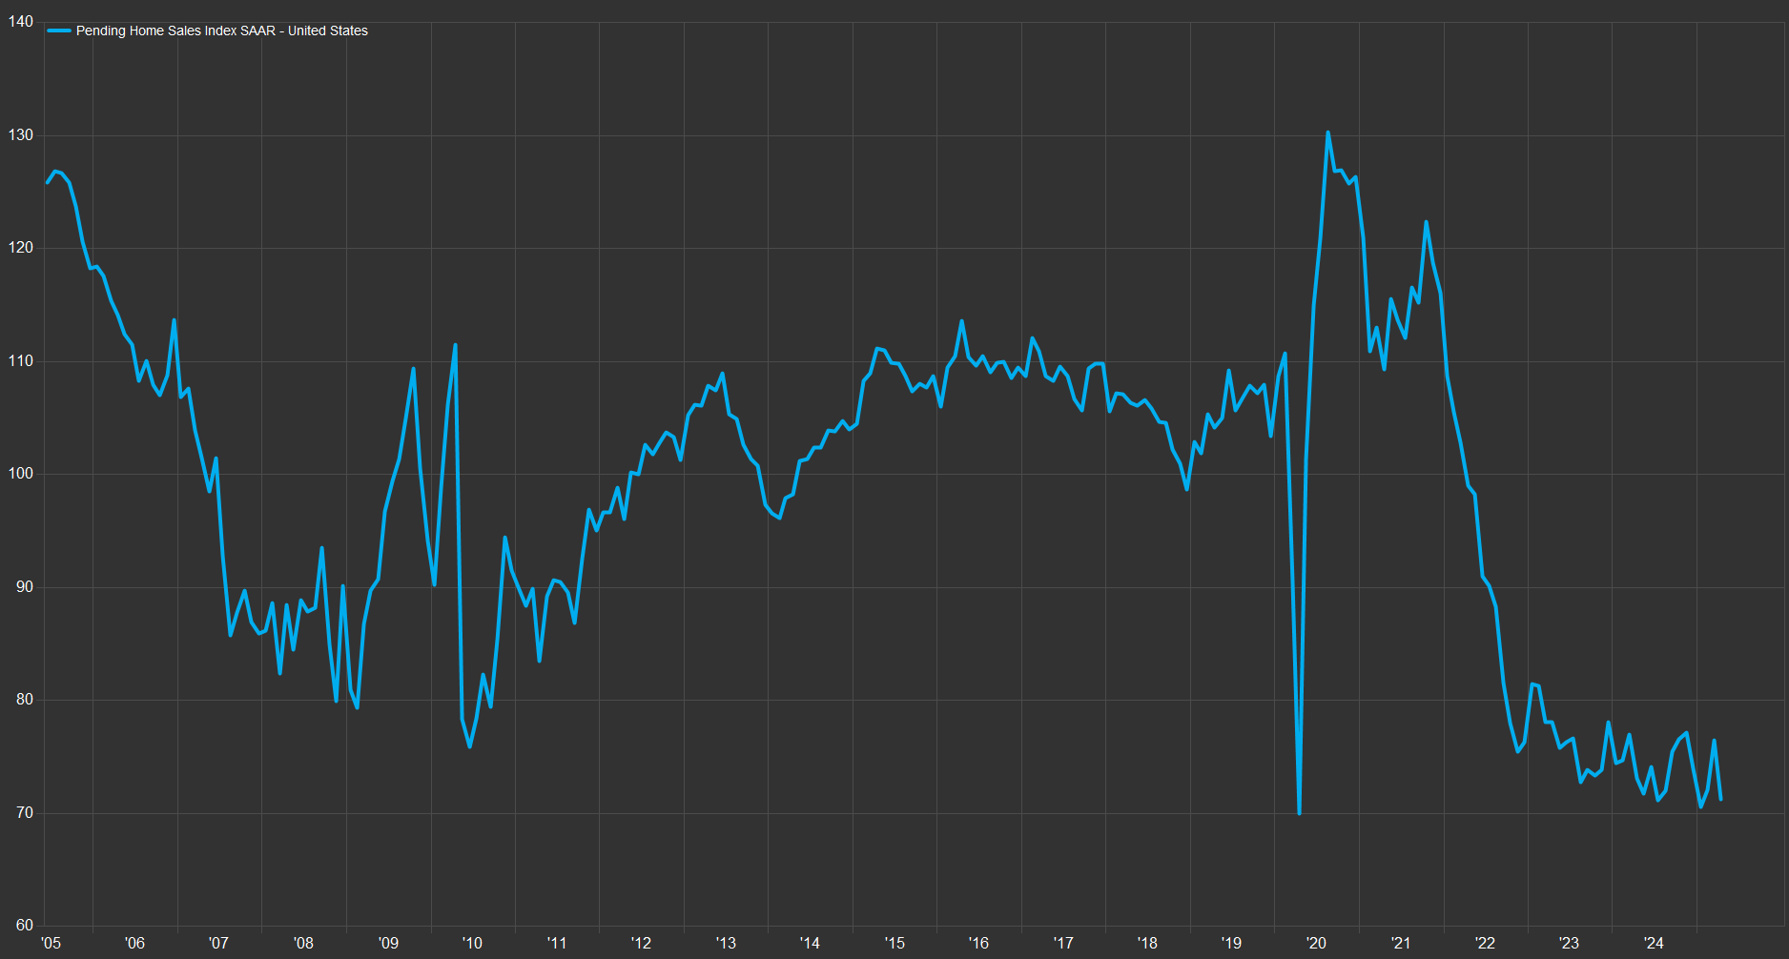
Pending Home Sales
Reach Multi-Decade Lows
Corporate Bond Spreads Widen
S&P 500 Energy Sector
Consumer Staples
S&P 500
Dollar General
Mag 7
Mag 7
Dollar General
Mag 7
Mag 7
Dollar Tree
Dollar Tree
WTI ($/bbl)
Health Care
Sources: BTC Capital Management, FactSet
Pending home sales in April fell 6.3% to the third lowest level in the last 25 years.
With 30-year mortgage rates edging close to 7% and continued concerns regarding potential higher costs due to tariffs, potential home buyers decided to stay on the sidelines.
Home builders have been discounting prices in efforts to combat the lackluster demand as home prices fell slightly in March, the first decline in prices in over two years.

Slide 6
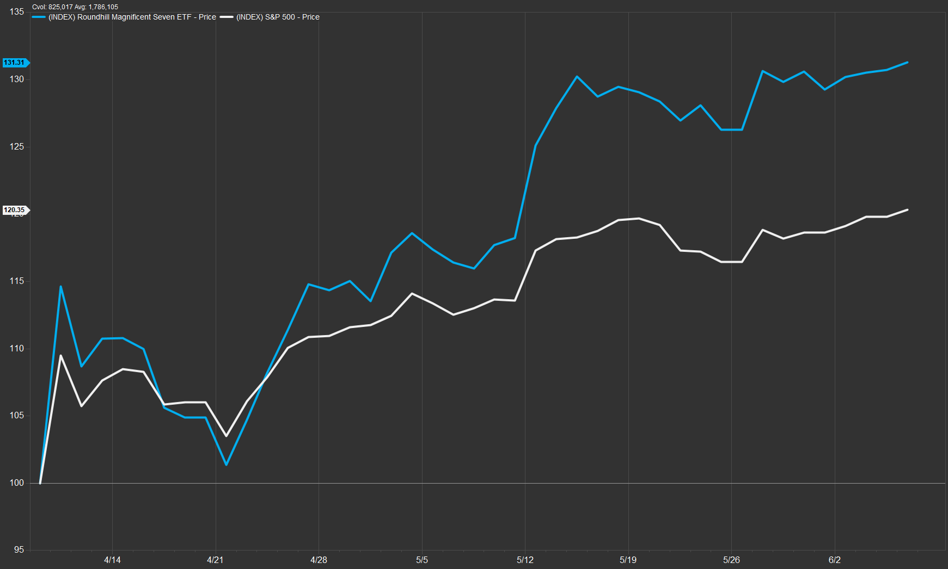
Magnificent 7 Outperforming Since Recent Market Bottom
S&P 500 Energy Sector
Mag 7
S&P 500
S&P 500
Mag 7
Dollar General
Mag 7
Dollar General
Mag 7
Dollar Tree
Mag 7
Dollar Tree
WTI ($/bbl)
4/8/25 – market bottom
Sources: BTC Capital Management, FactSet
Since the recent market bottom on April 8, the Magnificent 7 has come roaring back, gaining approximately 30% while the S&P 500 is up 20%.
Investors have invested a “risk-on” mentality of late, as flows have rotated back into the mega cap tech stocks.
NVIDIA (+47%) and Telsa (+50%) have seen significant gains since April 8 as investors now have assessed the potential impact of tariffs and have shifted investment flows to relatively longer duration stocks.

Slide 7
Disclosures
S&P 500 Energy Sector
Sources: BTC Capital Management, Bloomberg, FactSet, LSEG Datastream
The information provided has been obtained from sources deemed reliable, but BTC Capital Management and its affiliates cannot guarantee accuracy. Past performance is not a guarantee of future returns. Performance over periods exceeding 12 months has been annualized.
This document is intended for informational purposes only and is not an offer or solicitation with respect to the purchase or sale of any security. Statements in this report are based on the views of BTC Capital Management and on information available at the time this report was prepared. Rates are subject to change based on market and/or other conditions without notice. This commentary contains no investment recommendations, and you should not interpret any statement in this report as investment, tax, legal, and/or financial planning advice. All investments involve risk, including the possible loss of principal. Investments are not FDIC insured and may lose value.
S&P 500
Mag 7
Dollar General
Mag 7
Dollar Tree
WTI ($/bbl)

